Slide 1
Lab 2: Mixed-effects models
April 5, 2018

Slide 2
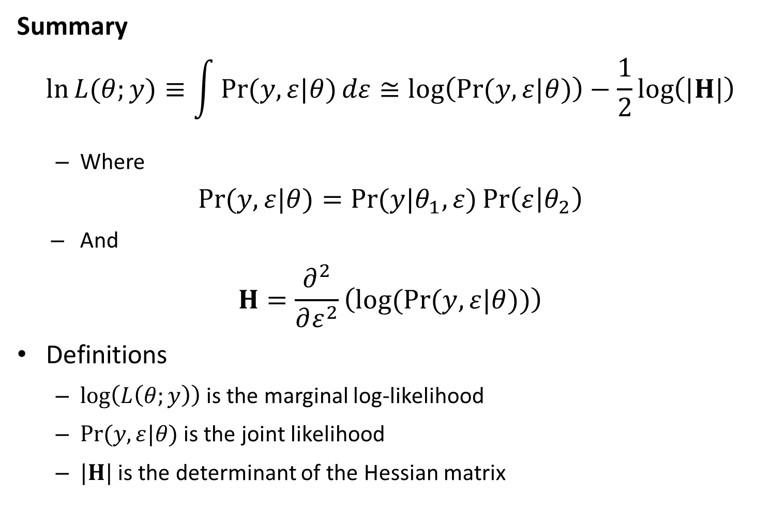
Likelihood statistics
Summary
$$\ln{L{(θ;y)}}≡\int{\operatorname{Pr}{(y,ε|θ)}dε}≅\log\left(\operatorname{Pr}{(y,ε|θ)}\right)−\frac{1}{2}\log\left(|H|\right)$$
Where
$$\operatorname{Pr}{(y,ε|θ)}=\operatorname{Pr}{(y|θ_{1},ε)}\operatorname{Pr}\left(ε | θ_{2}\right)$$
And
$$H=\frac{∂^{2}}{∂ε^{2}}\left(log(Pr{(y,ε|θ))}\right)$$
Definitions
$\log\left(L\left(θ;y\right)\right)$ is the marginal log-likelihood
$\operatorname{Pr}{(y,ε|θ)}$ is the joint likelihood
$|H|$ is the determinant of the Hessian matrix

Slide 3
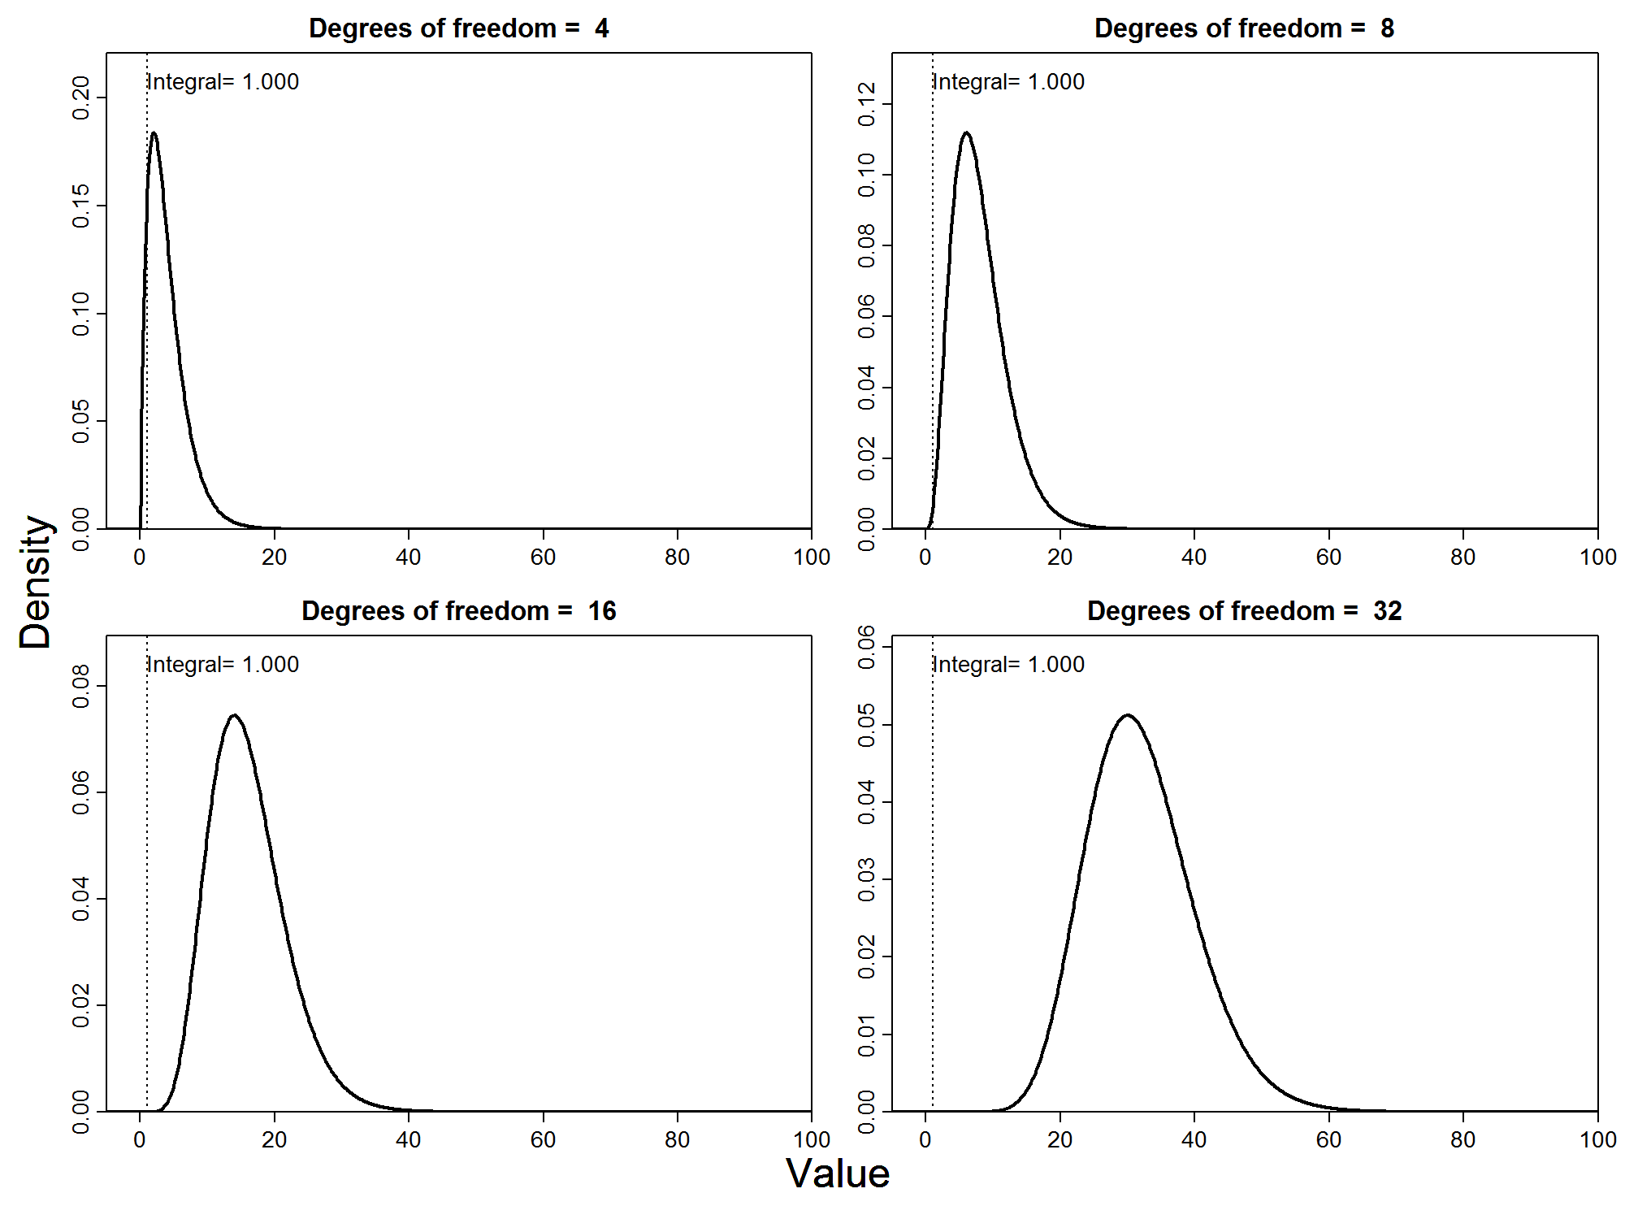

Slide 4
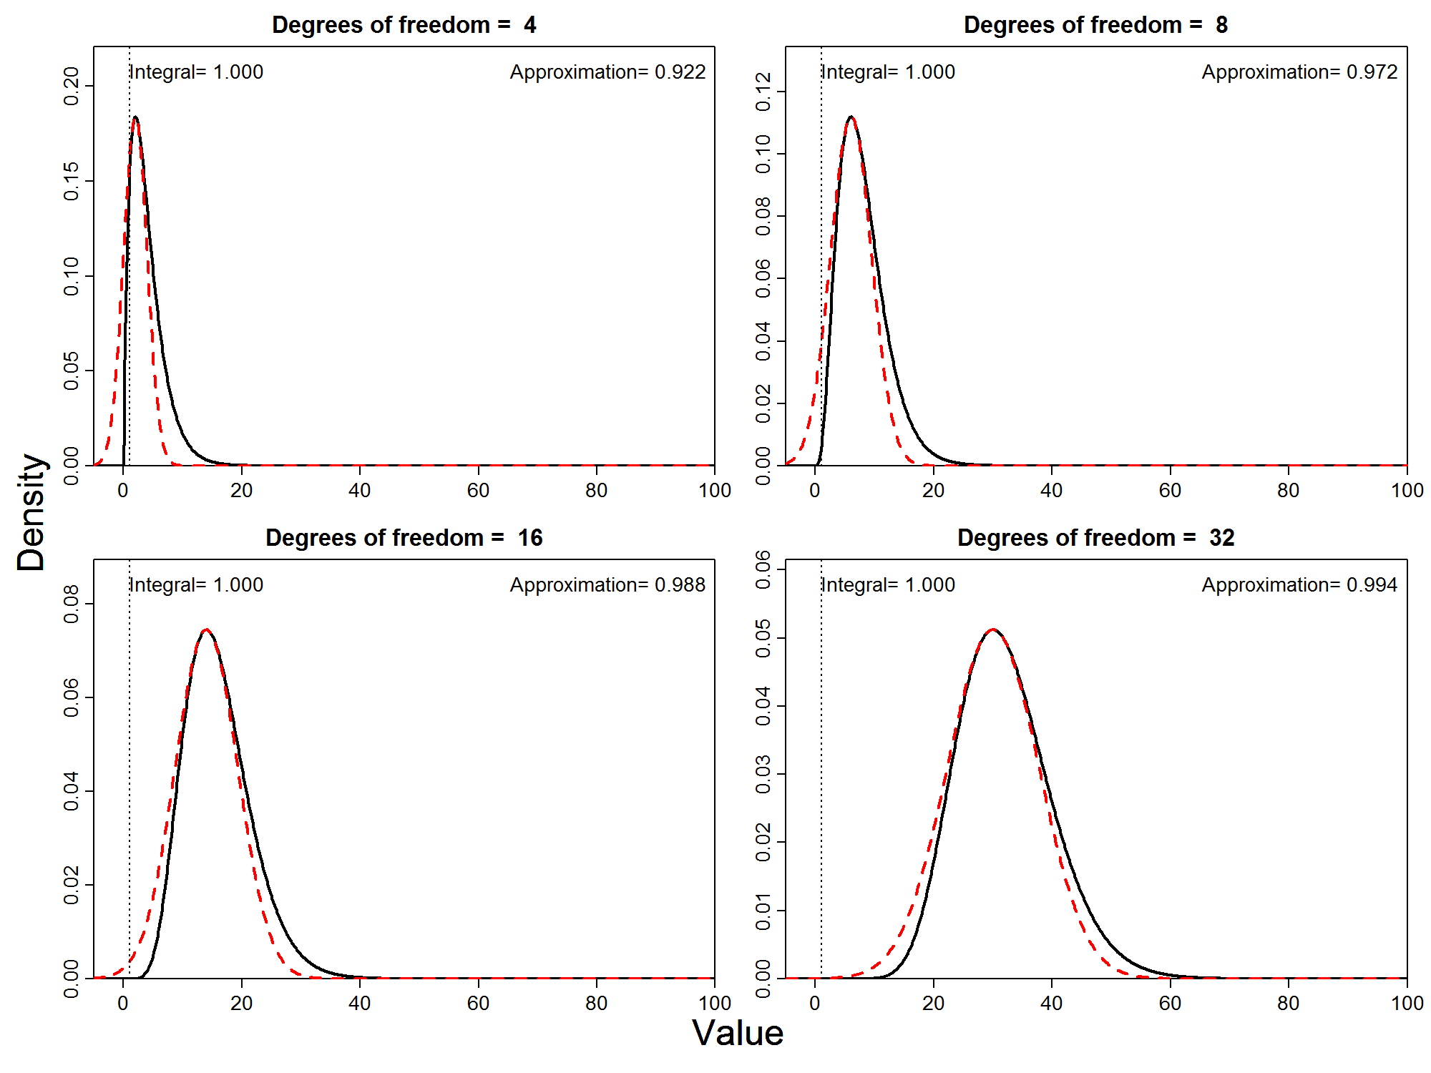

Slide 5
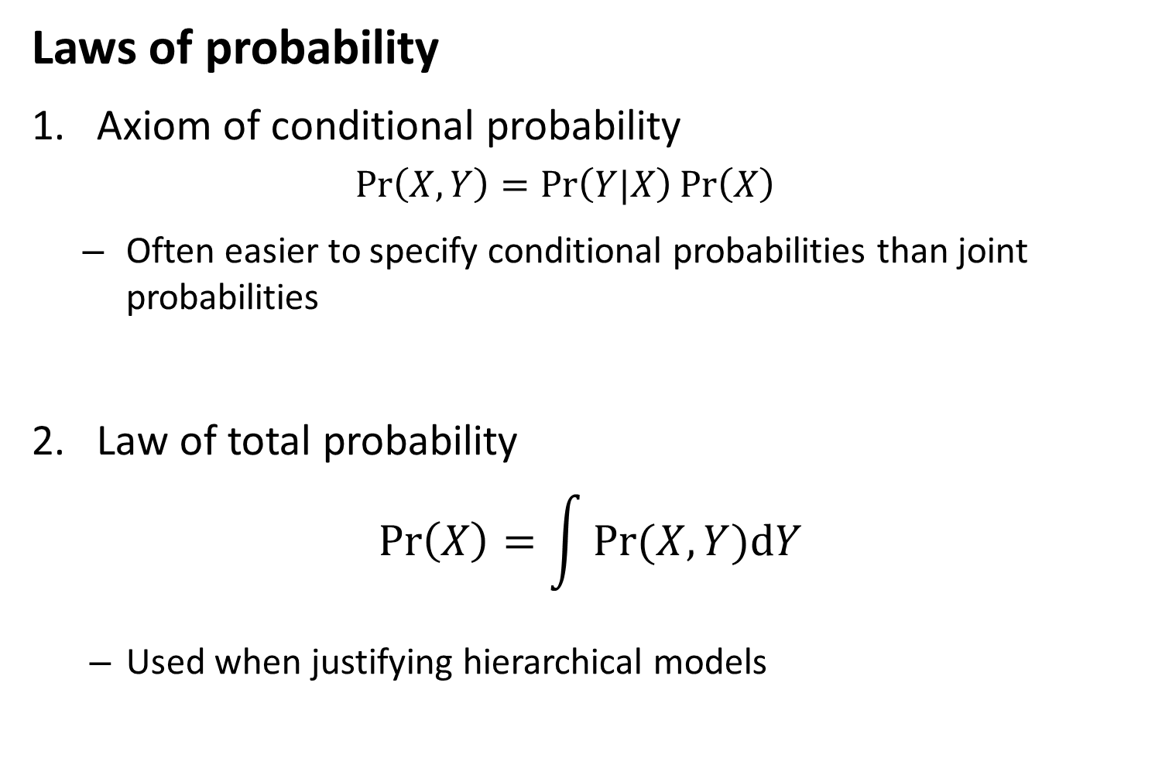
Mixed-effects models
Laws of probability
Axiom of conditional probability
$$\operatorname{Pr}\left(X,Y\right)=\operatorname{Pr}\left(Y|X\right)\operatorname{Pr}\left(X\right)$$
Often easier to specify conditional probabilities than joint probabilities
Law of total probability
$$\operatorname{Pr}\left(X\right)=\int{Pr⁡(X,Y)dY}$$
Used when justifying hierarchical models

Slide 6
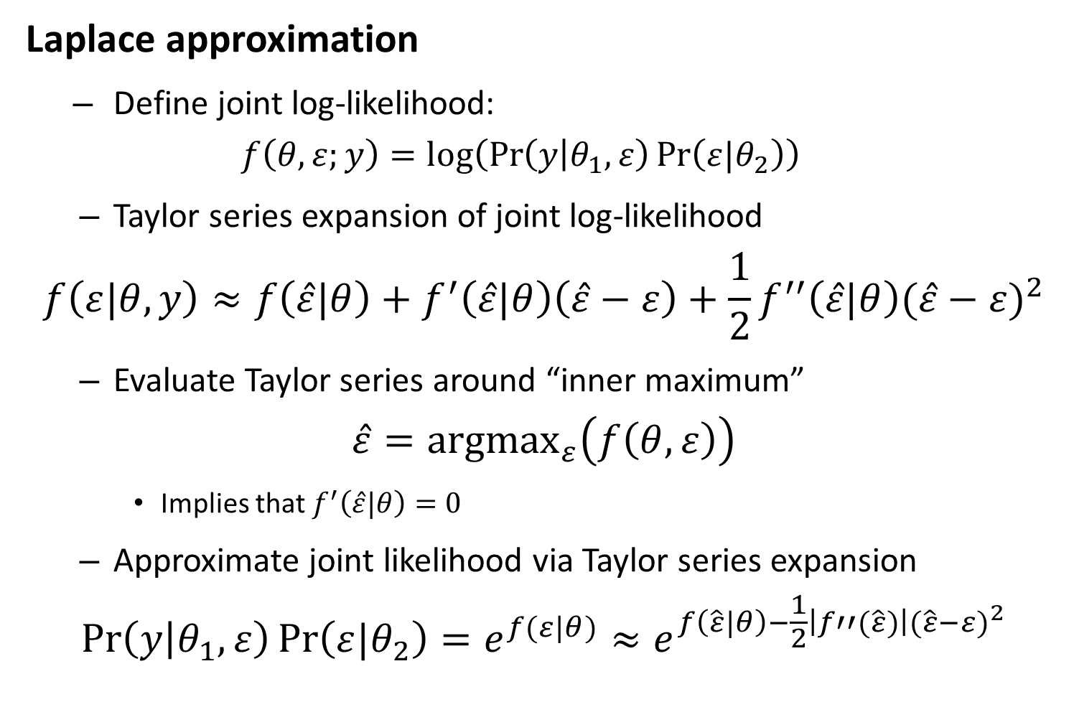
Likelihood statistics
Laplace approximation
Define joint log-likelihood:
$$f\left(θ,ε;y\right)=log⁡\left(\operatorname{Pr}\left(y | θ_{1},ε\right)\operatorname{Pr}\left(ε|θ_{2}\right)\right)$$
Taylor series expansion of joint log-likelihood
$$f\left(ε|θ,y\right)≈f\left(\hat{ε}|θ\right)+f^{′}\left(\hat{ε}|θ\right)\left(\hat{ε}−ε\right)+\frac{1}{2}f^{′′}\left(\hat{ε}|θ\right){(\hat{ε}−ε)}^{2}$$
Evaluate Taylor series around “inner maximum”
$$\hat{ε}={argmax}_{ε}\left(f\left(θ,ε\right)\right)$$
Implies that $f^{′}\left(\hat{ε}|θ\right)=0$
Approximate joint likelihood via Taylor series expansion
$$\operatorname{Pr}\left(y | θ_{1},ε\right)\operatorname{Pr}\left(ε|θ_{2}\right)=e^{f(ε|θ)}≈e^{f\left(\hat{ε}|θ\right)−\frac{1}{2}\left|f′′(\hat{ε})\right|{(\hat{ε}−ε)}^{2}}$$

Slide 7
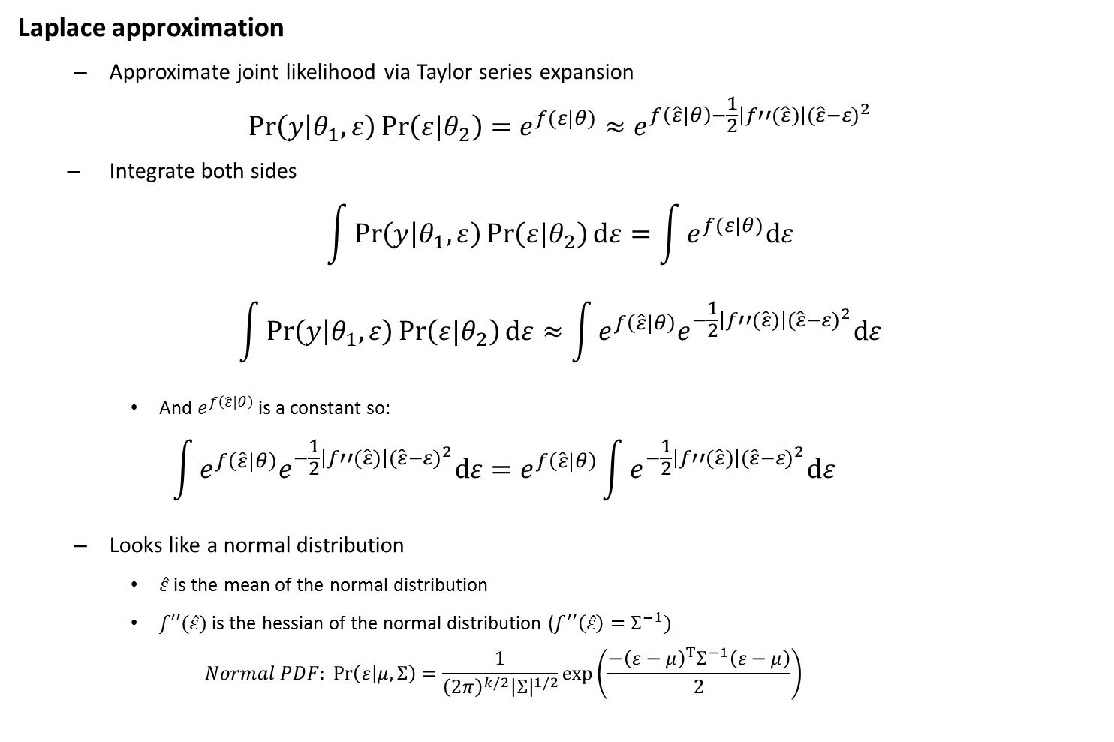
Likelihood statistics
Laplace approximation
Approximate joint likelihood via Taylor series expansion
$$\operatorname{Pr}\left(y | θ_{1},ε\right)\operatorname{Pr}\left(ε|θ_{2}\right)=e^{f(ε|θ)}≈e^{f\left(\hat{ε}|θ\right)−\frac{1}{2}\left|f′′(\hat{ε})\right|{(\hat{ε}−ε)}^{2}}$$
Integrate both sides
$$\int{\operatorname{Pr}\left(y | θ_{1},ε\right)\operatorname{Pr}\left(ε|θ_{2}\right)dε}=\int{e^{f(ε|θ)}dε}$$
$$\int{\operatorname{Pr}\left(y | θ_{1},ε\right)\operatorname{Pr}\left(ε|θ_{2}\right)dε}≈\int{e^{f\left(\hat{ε}|θ\right)}e^{−\frac{1}{2}\left|f′′(\hat{ε})\right|{(\hat{ε}−ε)}^{2}}dε}$$
And $e^{f\left(\hat{ε}|θ\right)}$ is a constant so:
$$\int{e^{f\left(\hat{ε}|θ\right)}e^{−\frac{1}{2}\left|f′′(\hat{ε})\right|{(\hat{ε}−ε)}^{2}}dε}=e^{f\left(\hat{ε}|θ\right)}\int{e^{−\frac{1}{2}\left|f′′(\hat{ε})\right|{(\hat{ε}−ε)}^{2}}dε}$$
Looks like a normal distribution
$\hat{ε}$ is the mean of the normal distribution
$f′′(\hat{ε})$ is the hessian of the normal distribution ($f^{′′}\left(\hat{ε}\right)=Σ^{−1})$
$$Normal PDF: \operatorname{Pr}\left(ε | μ,Σ\right)=\frac{1}{{\left(2π\right)}^{k/2}{\left|Σ\right|}^{1/2}}exp⁡\left(\frac{−{\left(ε−μ\right)}^{T}Σ^{−1}\left(ε−μ\right)}{2}\right)$$

Slide 8

Likelihood statistics
Chi-squared example
$$X\sim Chi.Squared(k)$$
$$\operatorname{Pr}\left(X=x\right)∝x^{\frac{k}{2}−1}e^{\frac{−x}{2}}$$
Defining the log-likelihood
$$\log\left(\operatorname{Pr}\left(x\right)\right)∝f(x)$$
Taking derivatives:
$$f\left(x\right)∝\left(\frac{k}{2}−1\right)\log\left(x\right)−\frac{x}{2}$$
$$f′\left(x\right)∝\left(\frac{k}{2}−1\right)x^{−1}−\frac{1}{2}$$
$$f′′\left(x\right)∝−\left(\frac{k}{2}−1\right)x^{−2}$$
Solving for mode and Hessian:
$$f^{′}\left(x\right)=0 → \hat{x}=k−2$$
$$f′′\left(\hat{x}\right)=−\left(\frac{1}{2\left(k−2\right)}\right)$$
Hence:
$$\operatorname{Pr}{(x)}∝Normal(k−2, 2\left(k−2\right))$$

Slide 9
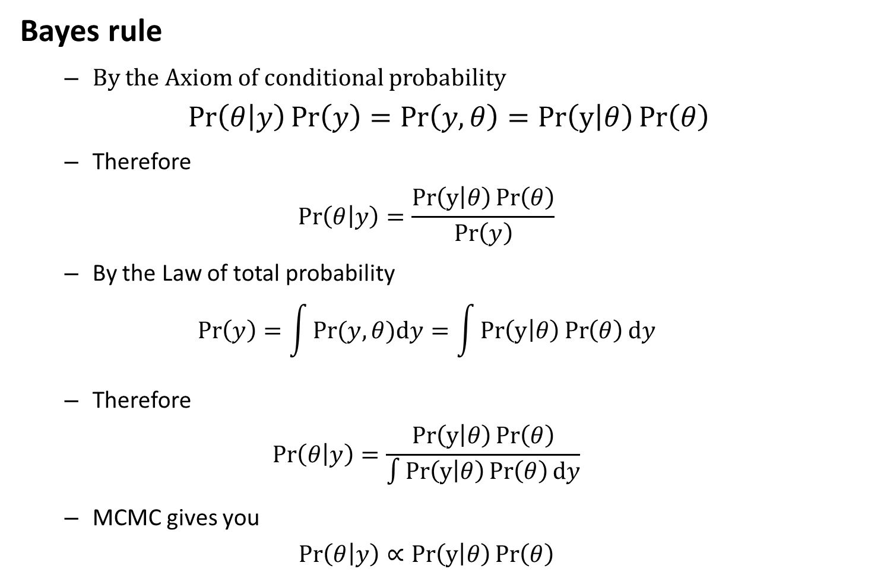
Mixed-effects models
Bayes rule
By the Axiom of conditional probability
$$\operatorname{Pr}\left(θ | y\right)\operatorname{Pr}\left(y\right)=\operatorname{Pr}\left(y,θ\right)=Pr\left(y | θ\right)\operatorname{Pr}\left(θ\right)$$
Therefore
$$\operatorname{Pr}\left(θ | y\right)=\frac{Pr\left(y | θ\right)\operatorname{Pr}\left(θ\right)}{\operatorname{Pr}\left(y\right)}$$
By the Law of total probability
$$\operatorname{Pr}\left(y\right)=\int{Pr⁡(y,θ)dy}=\int{Pr\left(y | θ\right)\operatorname{Pr}\left(θ\right)dy}$$
Therefore
$$\operatorname{Pr}\left(θ | y\right)=\frac{Pr\left(y | θ\right)\operatorname{Pr}\left(θ\right)}{\int{Pr\left(y | θ\right)\operatorname{Pr}\left(θ\right)dy}}$$
MCMC gives you
$$\operatorname{Pr}\left(θ | y\right)∝Pr\left(y | θ\right)\operatorname{Pr}\left(θ\right)$$

Slide 10
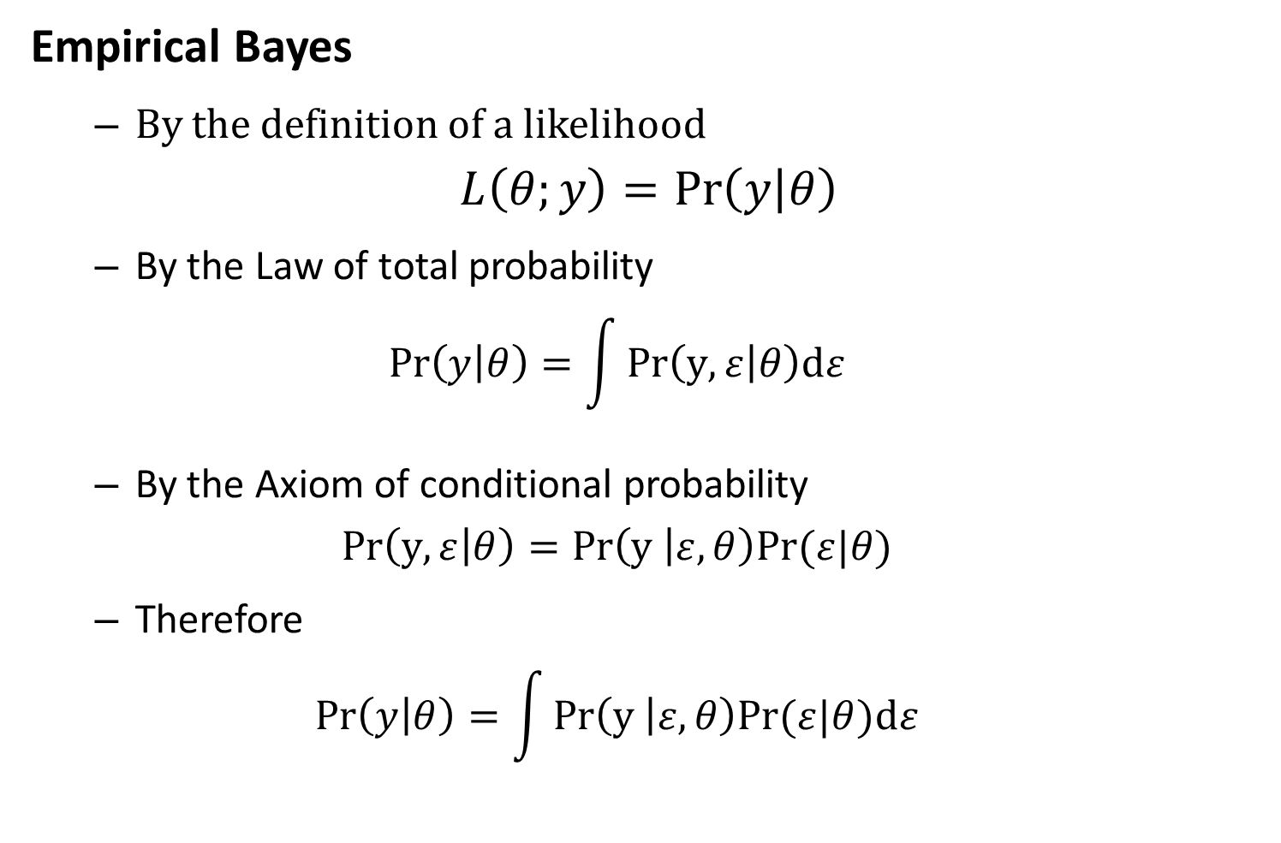
Mixed-effects models
Empirical Bayes
By the definition of a likelihood
$$L\left(θ;y\right)=\operatorname{Pr}\left(y | θ\right)$$
By the Law of total probability
$$\operatorname{Pr}\left(y | θ\right)=\int{Pr\left(y,ε | θ\right)dε}$$
By the Axiom of conditional probability
$$Pr\left(y,ε | θ\right)=Pr\left(y | ε,θ\right)Pr⁡(ε|θ)$$
Therefore
$$\operatorname{Pr}\left(y | θ\right)=\int{Pr\left(y | ε,θ\right)Pr⁡(ε|θ)dε}$$

Slide 11
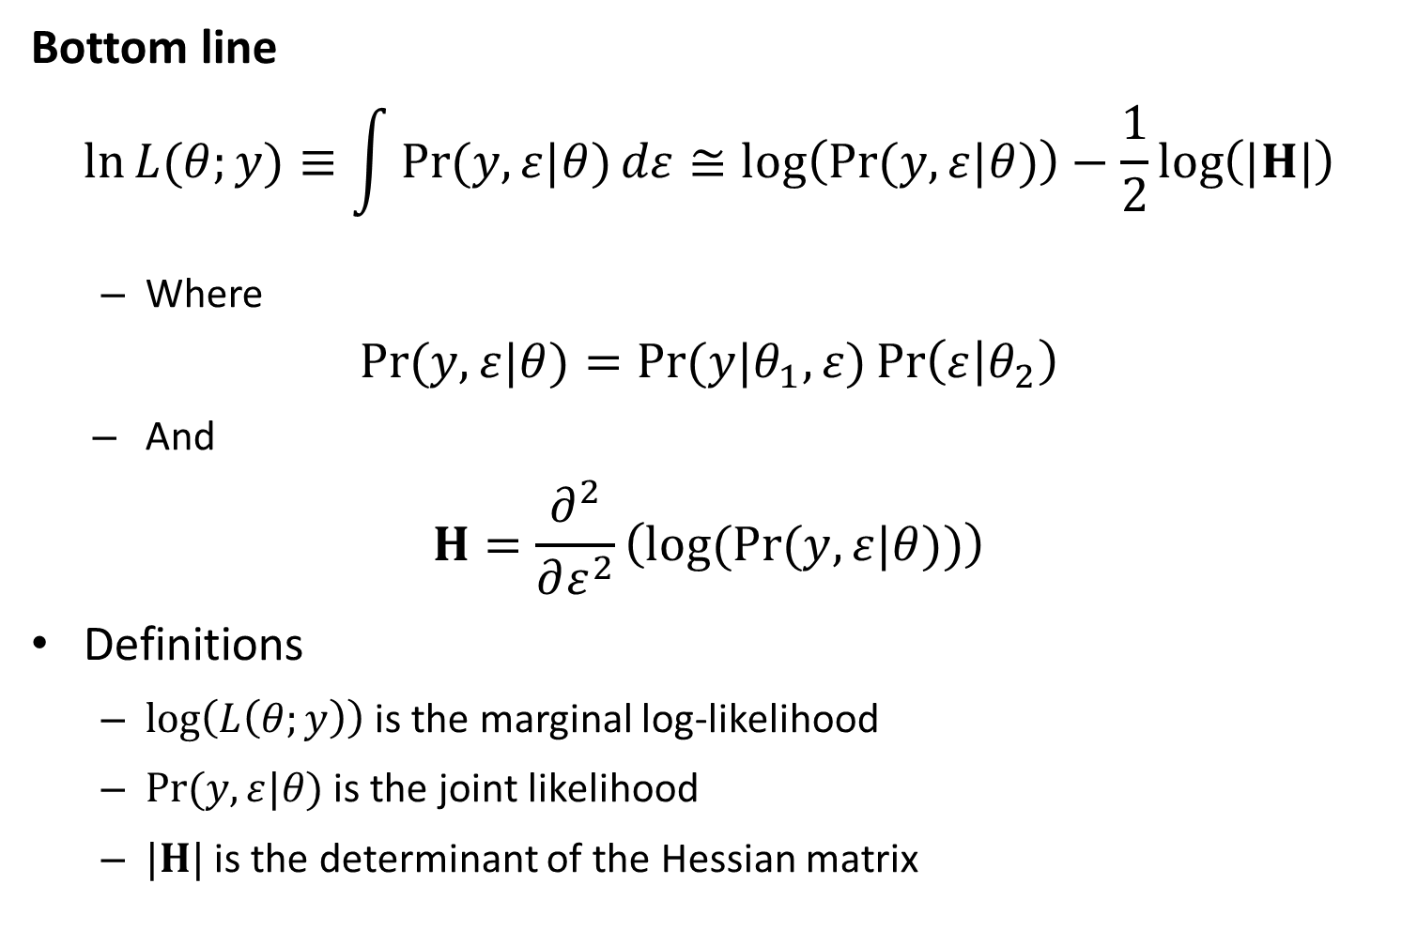
Likelihood statistics
Bottom line
$$\ln{L{(θ;y)}}≡\int{\operatorname{Pr}{(y,ε|θ)}dε}≅\log\left(\operatorname{Pr}{(y,ε|θ)}\right)−\frac{1}{2}\log\left(|H|\right)$$
Where
$$\operatorname{Pr}{(y,ε|θ)}=\operatorname{Pr}{(y|θ_{1},ε)}\operatorname{Pr}\left(ε | θ_{2}\right)$$
And
$$H=\frac{∂^{2}}{∂ε^{2}}\left(log(Pr{(y,ε|θ))}\right)$$
Definitions
$\log\left(L\left(θ;y\right)\right)$ is the marginal log-likelihood
$\operatorname{Pr}{(y,ε|θ)}$ is the joint likelihood
$|H|$ is the determinant of the Hessian matrix

Slide 12
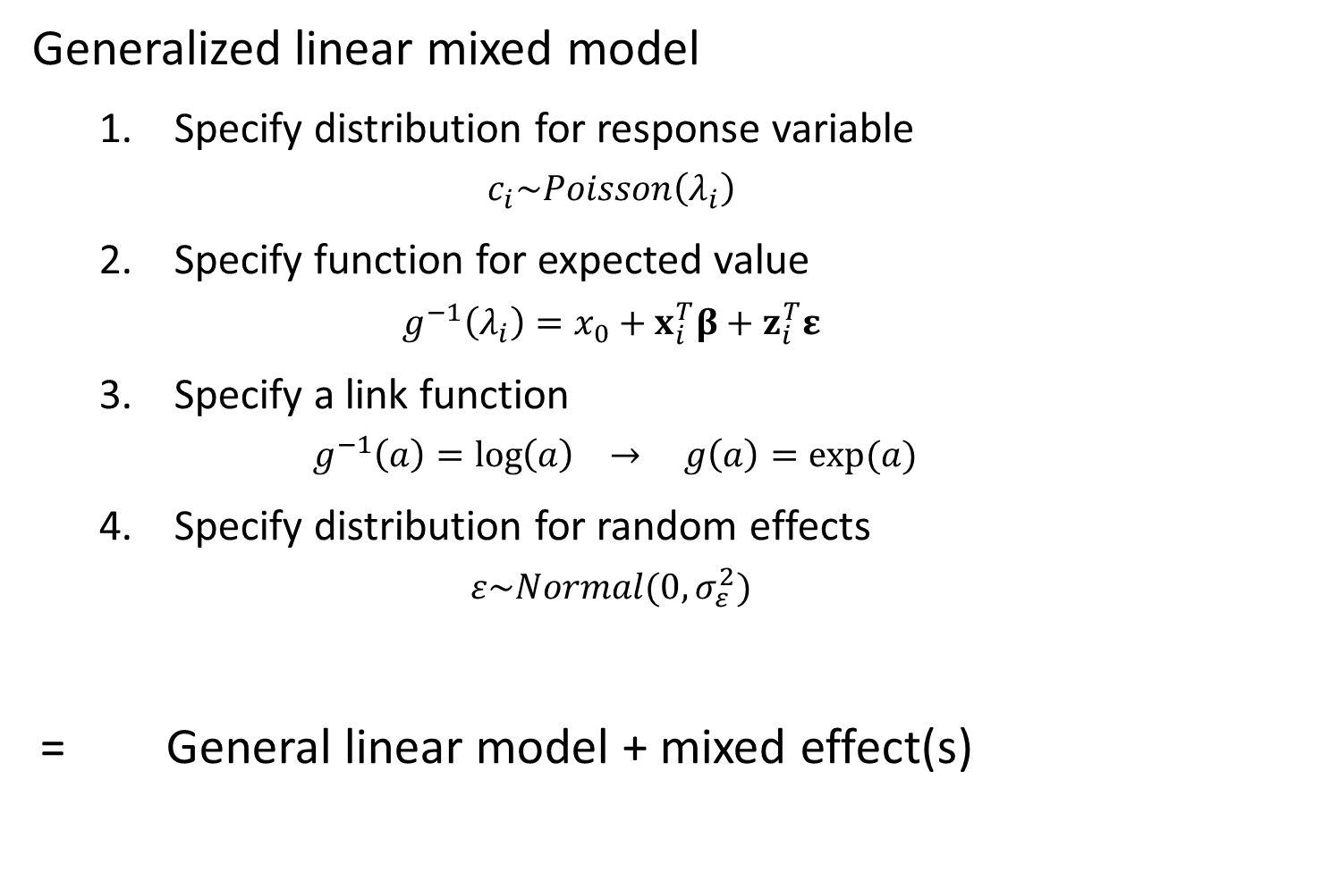
Mixed-effects models
Generalized linear mixed model
Specify distribution for response variable
$$c_{i}\sim Poisson\left(λ_{i}\right)$$
Specify function for expected value
$$g^{−1}\left(λ_{i}\right)=x_{0}+x_{i}^{T}β+z_{i}^{T}ε$$
Specify a link function
$$g^{−1}\left(a\right)=\log\left(a\right) → g\left(a\right)=exp⁡(a)$$
Specify distribution for random effects
$$ε\sim Normal(0,σ_{ε}^{2})$$
= General linear model + mixed effect(s)

Slide 13
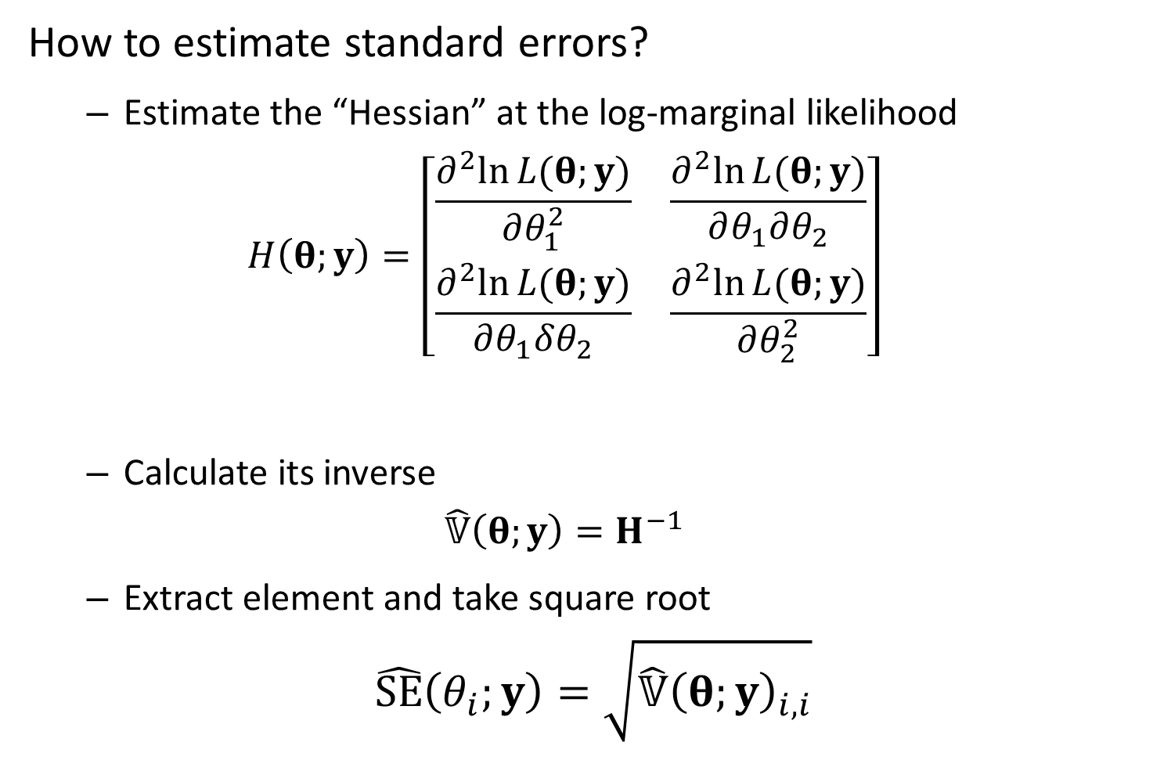
Mixed-effects models
How to estimate standard errors?
Estimate the “Hessian” at the log-marginal likelihood
$$H\left(θ;y\right)=\left[\begin{matrix}\frac{∂^{2}ln⁡L(θ;y)}{∂θ_{1}^{2}} & \frac{∂^{2}ln⁡L(θ;y)}{∂θ_{1}∂θ_{2}} \\ \frac{∂^{2}ln⁡L(θ;y)}{∂θ_{1}δθ_{2}} & \frac{∂^{2}ln⁡L(θ;y)}{∂θ_{2}^{2}}\end{matrix}\right]$$
Calculate its inverse
$$\hat{𝕍}\left(θ;y\right)=H^{−1}$$
Extract element and take square root
$$\hat{SE}\left(θ_{i};y\right)=\sqrt{\hat{𝕍}{\left(θ;y\right)}_{i,i}}$$

Slide 14
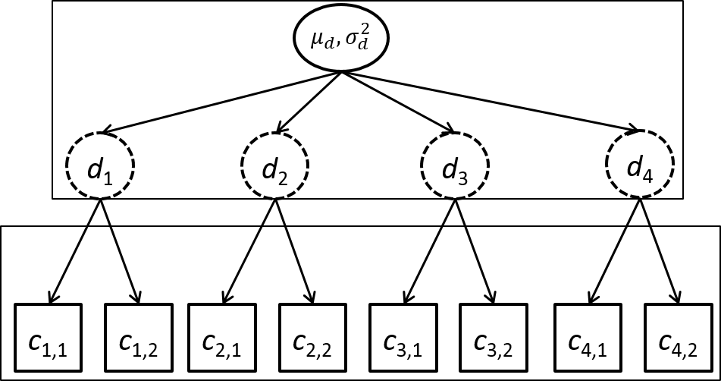

Mixed-effects models
Example – Hierarchical count samples
$$log⁡(d_{j})\sim Normal(μ_{d},σ_{d}^{2})$$
$$c_{i,j}\sim Poisson(d_{j})$$
Counts
4 sites
2 observations/site
3 fixed effects
4 random effects

Slide 15
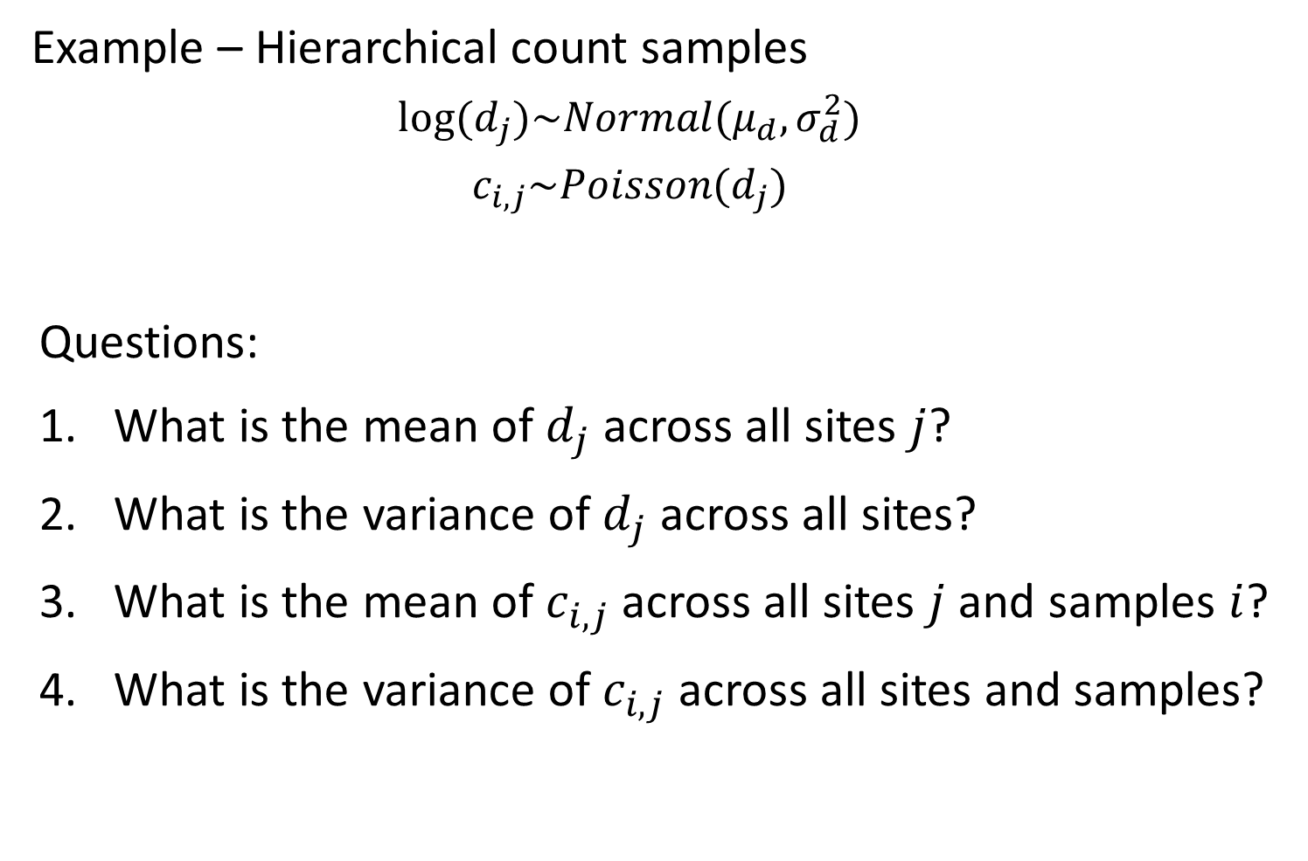
Mixed-effects models
Example – Hierarchical count samples
$$log⁡(d_{j})\sim Normal(μ_{d},σ_{d}^{2})$$
$$c_{i,j}\sim Poisson(d_{j})$$
Questions:
What is the mean of $d_{j}$ across all sites $j$?
What is the variance of $d_{j}$ across all sites?
What is the mean of $c_{i,j}$ across all sites $j$ and samples $i$?
What is the variance of $c_{i,j}$ across all sites and samples?

Slide 16
Mixed-effects models
Simulating data
[See R code]

Slide 17
Mixed-effects models
Fit using R
Using lme4 package
formula: way to specify model
Linear model – lm(formula= … )
Count ~ 0 + factor(Site)
“Count” – response variable
“0” – Don’t include intercept
“factor(Site)” – Include a fixed effect for each site
Linear mixed model – lm(formula = … | … )
Count ~ ( 1 | factor(Site))
“( 1 | factor(Site) )” – Include a random effect for each site

Slide 18
Mixed-effects models
Fit using R
[See R code]

Slide 19
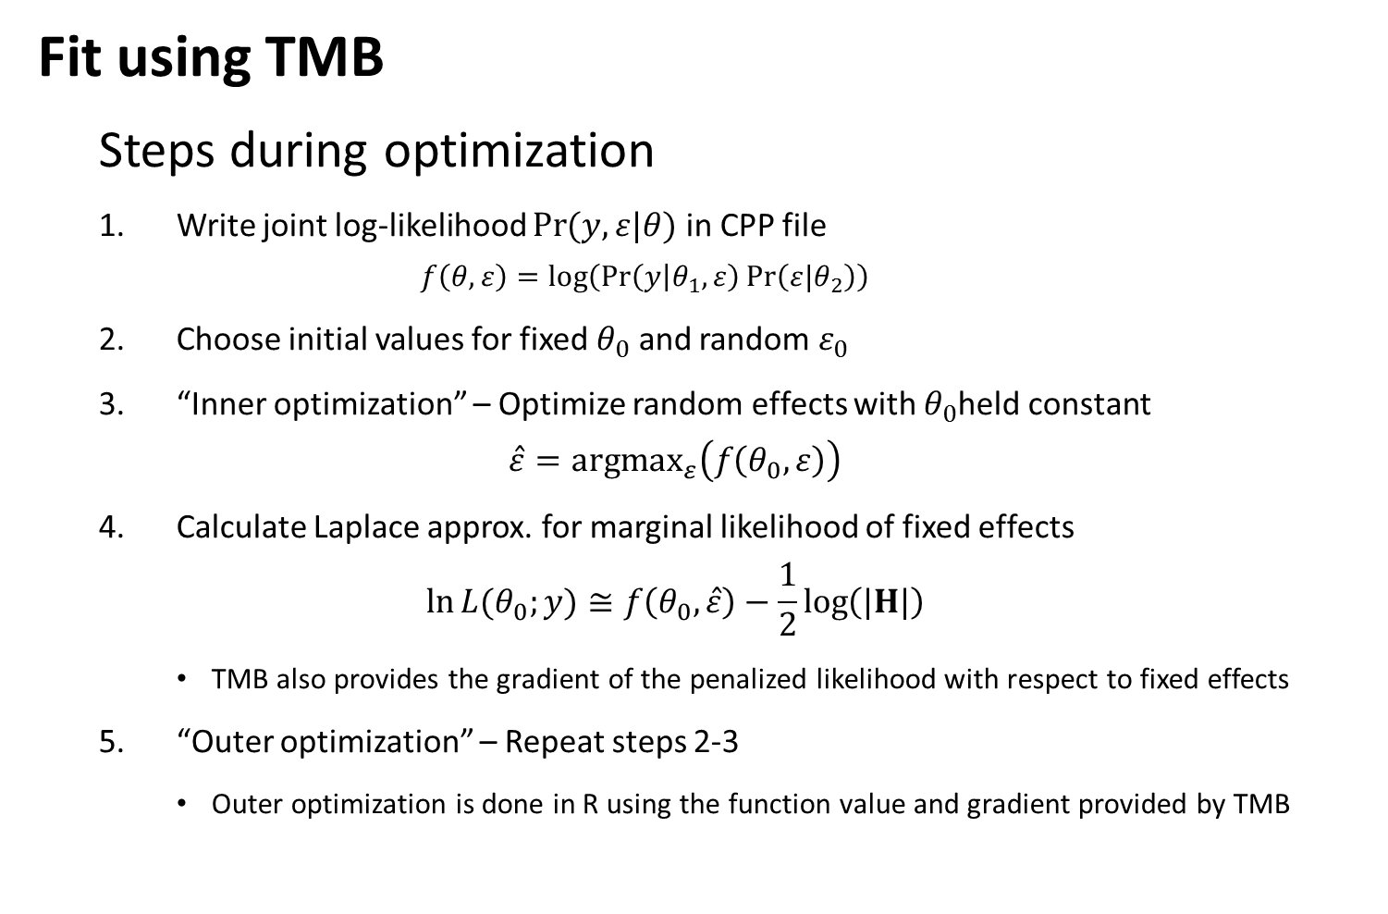
Mixed-effects models
Fit using TMB
Steps during optimization
Write joint log-likelihood $\operatorname{Pr}{(y,ε|θ)}$ in CPP file
$$f\left(θ,ε\right)=log⁡\left(\operatorname{Pr}\left(y | θ_{1},ε\right)\operatorname{Pr}\left(ε|θ_{2}\right)\right)$$
Choose initial values for fixed $θ_{0}$ and random $ε_{0}$
“Inner optimization” – Optimize random effects with $θ_{0}$held constant
$$\hat{ε}={argmax}_{ε}\left(f\left(θ_{0},ε\right)\right)$$
Calculate Laplace approx. for marginal likelihood of fixed effects
$$\ln{L{(θ_{0};y)}}≅f\left(θ_{0},\hat{ε}\right)−\frac{1}{2}\log\left(|H|\right)$$
TMB also provides the gradient of the penalized likelihood with respect to fixed effects
“Outer optimization” – Repeat steps 2-3
Outer optimization is done in R using the function value and gradient provided by TMB

Slide 20
Mixed-effects models
Fit using TMB
[See R code]

Slide 21
Mixed-effects models
Benefits of using linear mixed models
Separate estimate of measurement and between-site variability
Include covariates for either one
Improved precision
“Shrinkage”
Draw-backs
Biased if random effects aren’t “exchangeable”

Slide 22
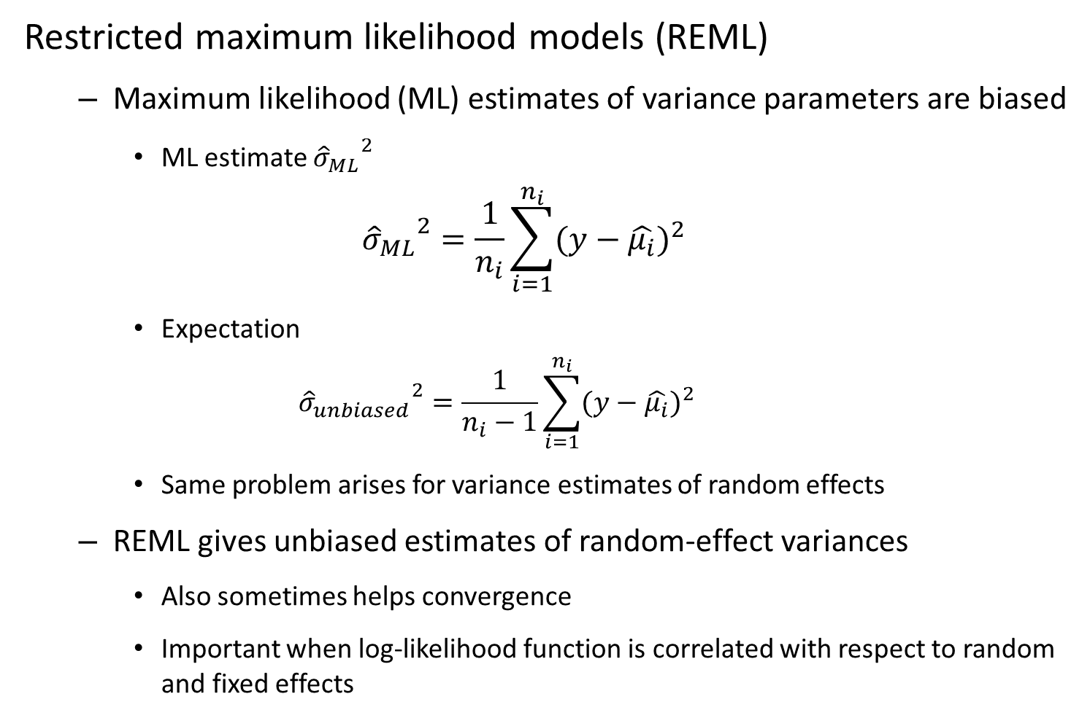
Mixed-effects models
Restricted maximum likelihood models (REML)
Maximum likelihood (ML) estimates of variance parameters are biased
ML estimate ${{\hat{σ}}_{ML}}^{2}$
$${{\hat{σ}}_{ML}}^{2}=\frac{1}{n_{i}}\sum_{i=1}^{n_{i}}{(y−{\hat{μ_{i}})}^{2}}$$
Expectation
$${{\hat{σ}}_{unbiased}}^{2}=\frac{1}{n_{i}−1}\sum_{i=1}^{n_{i}}{(y−{\hat{μ_{i}})}^{2}}$$
Same problem arises for variance estimates of random effects
REML gives unbiased estimates of random-effect variances
Also sometimes helps convergence
Important when log-likelihood function is correlated with respect to random and fixed effects

Slide 23
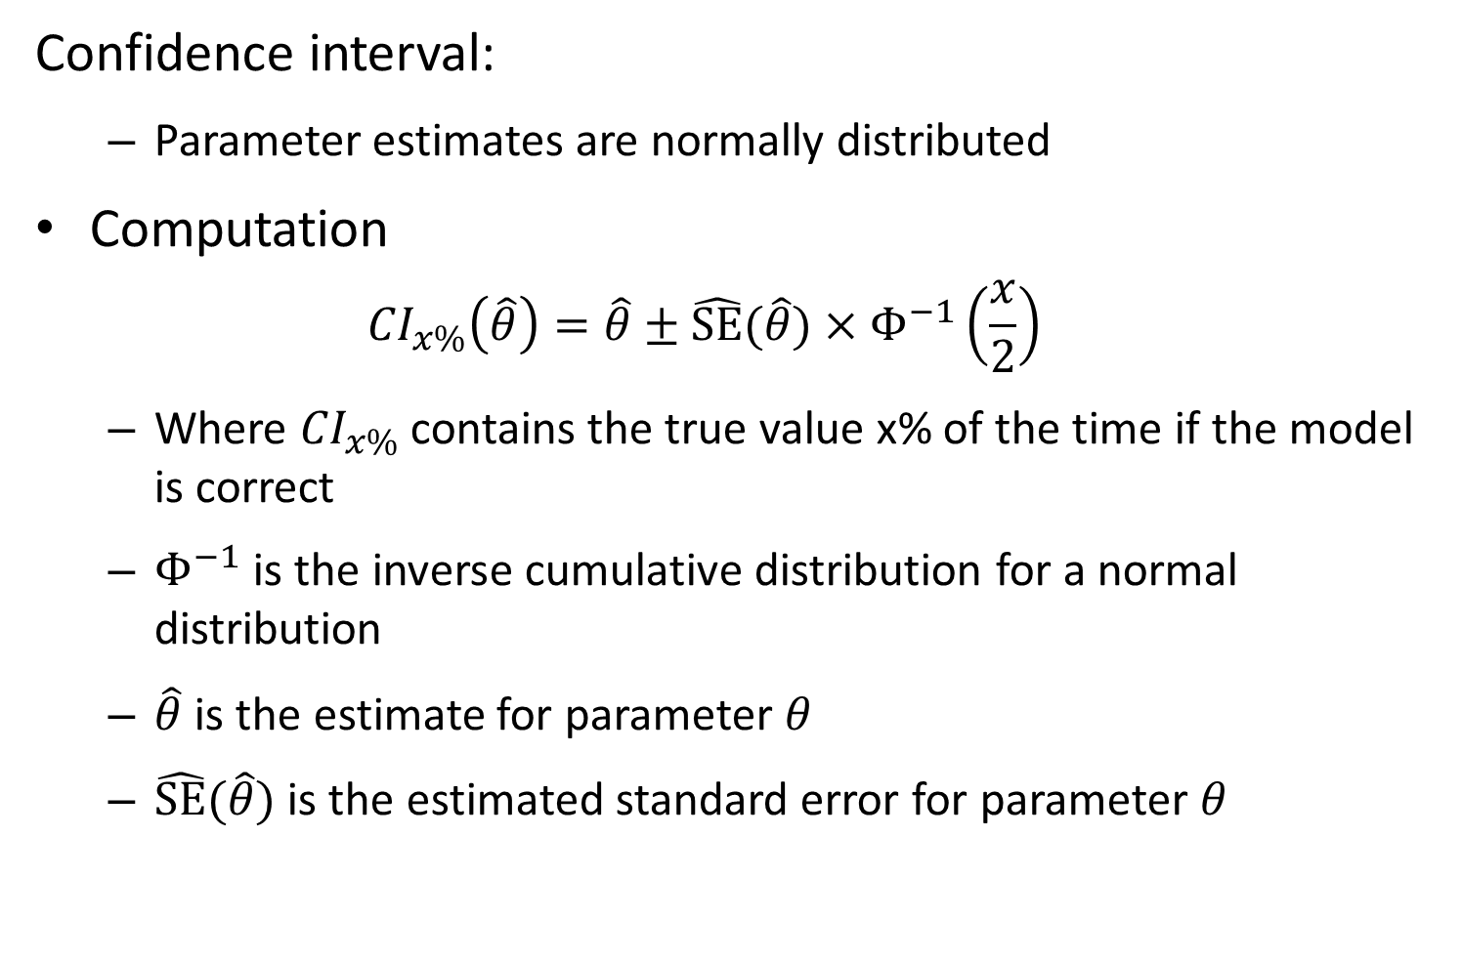
Confidence interval:
Parameter estimates are normally distributed
Computation
$${CI}_{x\%}\left(\hat{θ}\right)=\hat{θ}±\hat{SE}(\hat{θ})×Φ^{−1}\left(\frac{x}{2}\right)$$
Where ${CI}_{x\%}$ contains the true value x% of the time if the model is correct
$Φ^{−1}$ is the inverse cumulative distribution for a normal distribution
$\hat{θ}$ is the estimate for parameter $θ$
$\hat{SE}(\hat{θ})$ is the estimated standard error for parameter $θ$

Slide 24
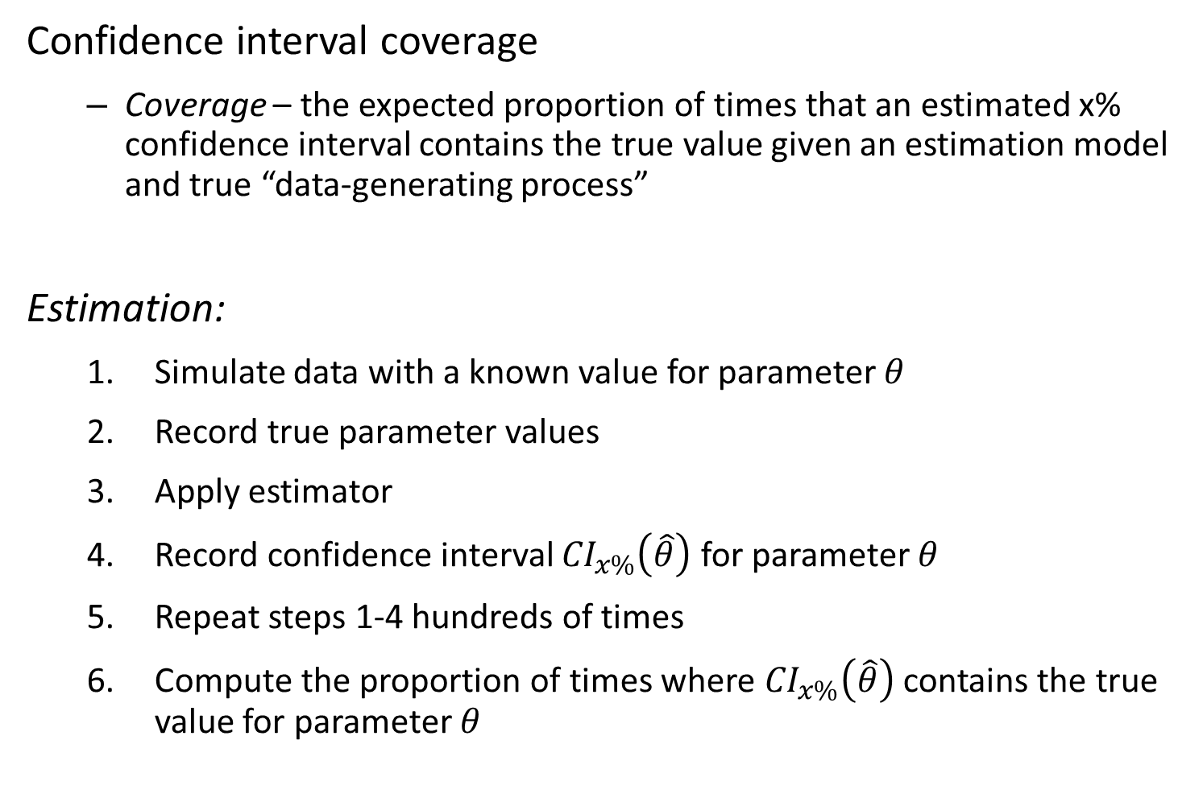
Confidence interval coverage
Coverage – the expected proportion of times that an estimated x% confidence interval contains the true value given an estimation model and true “data-generating process”
Estimation:
Simulate data with a known value for parameter $θ$
Record true parameter values
Apply estimator
Record confidence interval ${CI}_{x\%}\left(\hat{θ}\right)$ for parameter $θ$
Repeat steps 1-4 hundreds of times
Compute the proportion of times where ${CI}_{x\%}\left(\hat{θ}\right)$ contains the true value for parameter $θ$

Slide 25
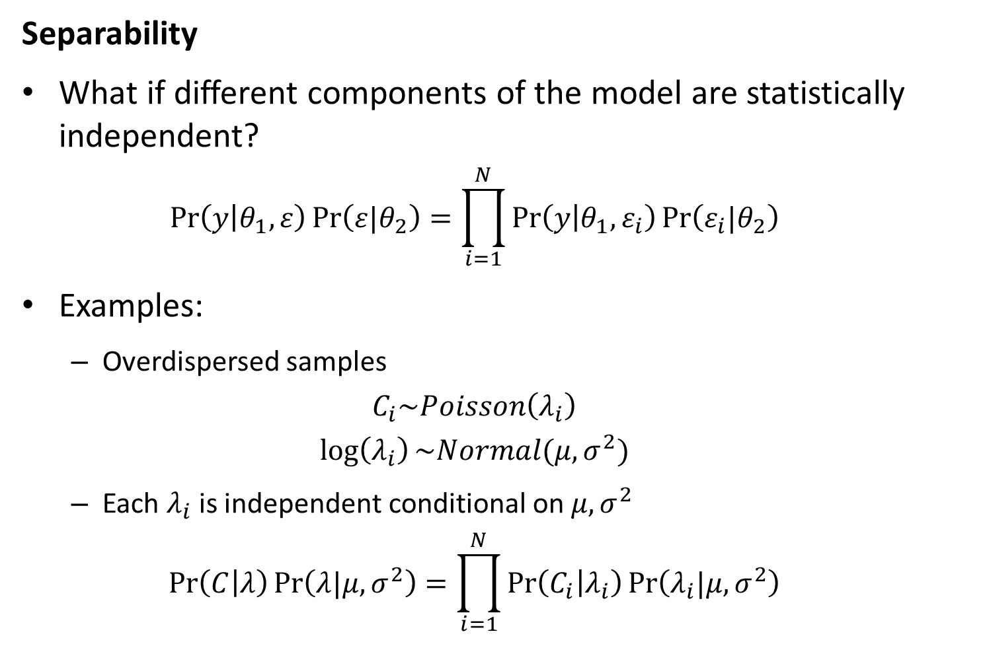
Likelihood statistics
Separability
What if different components of the model are statistically independent?
$$\operatorname{Pr}\left(y | θ_{1},ε\right)\operatorname{Pr}\left(ε|θ_{2}\right)=\prod_{i=1}^{N}{\operatorname{Pr}\left(y | θ_{1},ε_{i}\right)\operatorname{Pr}\left(ε_{i}|θ_{2}\right)}$$
Examples:
Overdispersed samples
$$C_{i}\sim Poisson\left(λ_{i}\right)$$
$$\log\left(λ_{i}\right)\sim Normal(μ,σ^{2})$$
Each $λ_{i}$ is independent conditional on $μ,σ^{2}$
$$\operatorname{Pr}\left(C | λ\right)\operatorname{Pr}\left(λ|μ,σ^{2}\right)=\prod_{i=1}^{N}{\operatorname{Pr}\left(C_{i} | λ_{i}\right)\operatorname{Pr}\left(λ_{i}|μ,σ^{2}\right)}$$

Slide 26
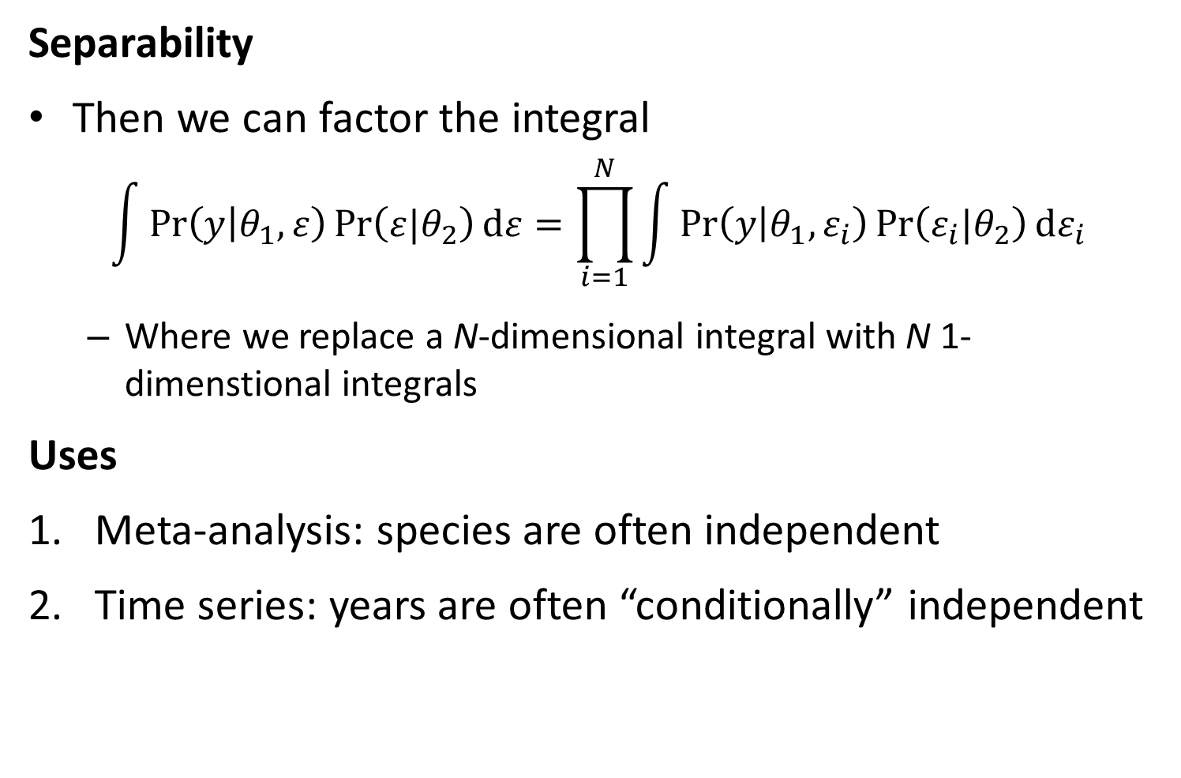
Likelihood statistics
Separability
Then we can factor the integral
$$\int{\operatorname{Pr}\left(y | θ_{1},ε\right)\operatorname{Pr}\left(ε|θ_{2}\right)dε}=\prod_{i=1}^{N}{\int{\operatorname{Pr}\left(y | θ_{1},ε_{i}\right)\operatorname{Pr}\left(ε_{i}|θ_{2}\right)dε_{i}}}$$
Where we replace a N-dimensional integral with N 1-dimenstional integrals
Uses
Meta-analysis: species are often independent
Time series: years are often “conditionally” independent

Slide 27
Mixed-effects models
[Explore “map” argument to TMB]

